Slide 1




Practical Steps To Modernizing Legacy Applications
An Architectural Journey
Gregory A. Beamer
@gbworld

Slide 2
Practical Steps to Modernizing Legacy Applications
Who Am I?
What Is Legacy?
How Do We Determine What To Modernize?
How Do We Modernize?
Architectural Examples – Big Pretty Pictures?

Slide 3
Who Am I?
And Why Am I Qualified to Speak On This Topic

Slide 4

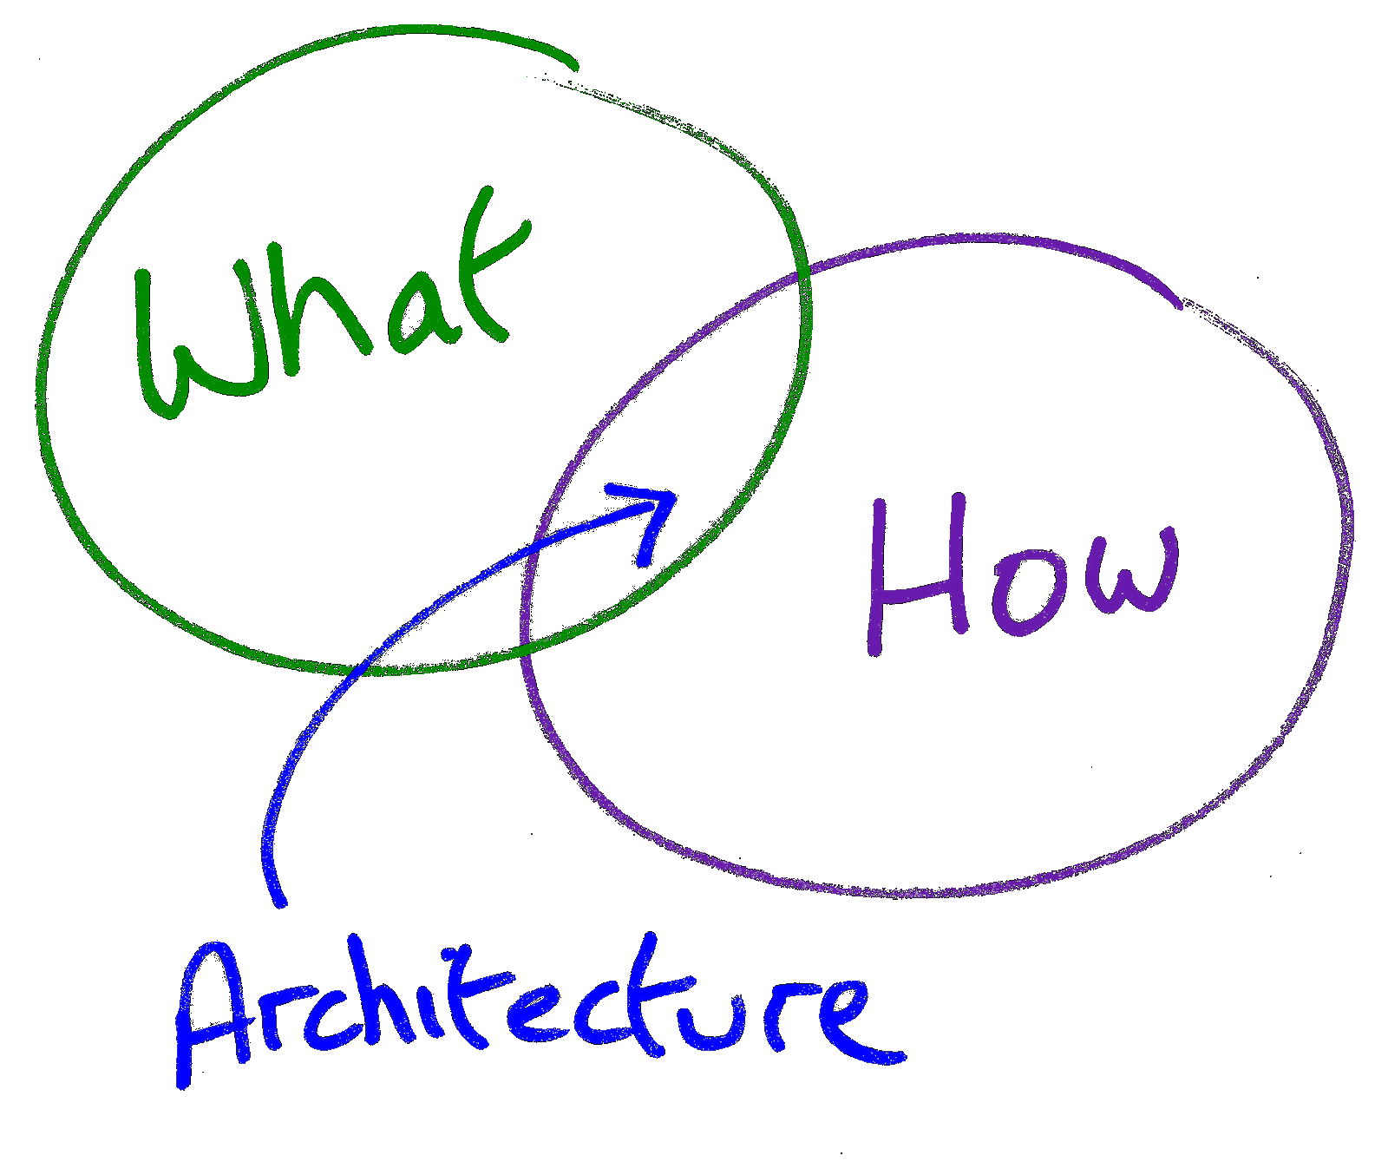
Current Position: VP Of Technological, Ventures
Previous: Enterprise Architect, Consultant
Notes:
Most important is years as a consultant

Slide 5



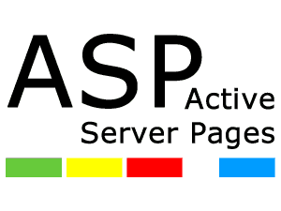
Who Am I?
Notes:
Some legacy migrations in the Microsoft world

Slide 6

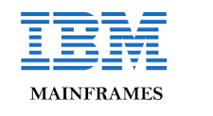
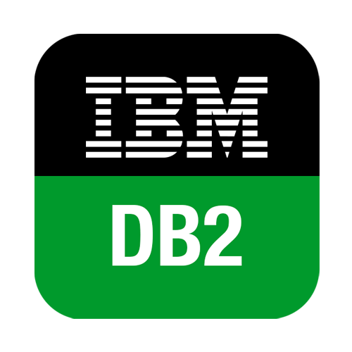
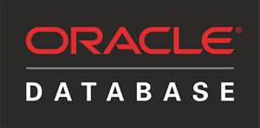

Who Am I?

Slide 7
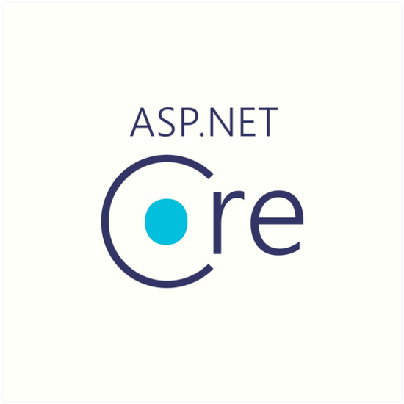

Who Am I?
Notes:
These would normally be refactoring, not modernization, but the steps are very similar.

Slide 8
What is Legacy?
Rethinking This Talk

Slide 9
What Is Legacy?
Moving from Mainframe to .NET or Java
Moving From VB to .NET
Moving From ASP.NET Web Forms to MVC (or Core)
Moving From .NET 1.x to .NET 4.x
Moving From .NET 4.6 to .NET 4.6
Moving from Mainframe to .NET or Java
Moving From VB to .NET
Moving From ASP.NET Web Forms to MVC (or Core)
Moving From .NET 1.x to .NET 4.x
Moving From .NET 4.6 to .NET 4.6
Notes:
General thought is legacy == old (red would normally be “out of legacy modernization scope” I will challenge this

Slide 10
What is Legacy?
Legacy == REBUILD, AKA Modernize
Non-Legacy == Refactor
Notes:
Normal thoughts on how you handle code. I will challenge this too.

Slide 11
What Is Legacy?
Legacy is Code that is No Longer Properly Serving Business in an Acceptable Manner.
Legacy
Old Technology
Old Techniques/Methods
Non-Legacy
Bad Design/Architectural Decisions
Impossible to Maintain
Notes:
Digging deeper, bad design/architecture can be legacy and require a legacy (rebuild) approach. Also something so tangled it is more expensive to untangle than it is to punt.

Slide 12

What is Legacy?
Legacy == Modernize
Non-Legacy == Refactor
Notes:
Point: Legacy and non-legacy still require the same approach (2 sides, 1 coin)

Slide 13
How Do We Determine What to Modernize?
Rationalizing Application Modernization (And Refactoring)

Slide 14
It’s About
T
I
M
E
NOT WORTH INVESTMENT
WORTH INVESTMENT
KEEP CODE
OLERATE
NVEST
REJECT CODE
LIMINATE
IGRATE
Notes:
This is an application rationalization matrix. (Tolerate, Invest, Eliminate, Migrate). Decision points 1. Is it worth investing in? 2. Are we keeping the code or rebuilding (reject)?
More info: https://www.google.com/search?safe=off&source=hp&ei=VaM3XLaHNqXs5gKN9ZPYBA&q=portfolio+rationalization&btnK=Google+Search&oq=portfolio+rationalization&gs_l=psy-ab.3..0l3j0i22i30l7.4991.12981..13226...7.0..0.409.3612.15j14j1j0j1......0....1..gws-wiz.....6..35i39j0i131j0i13j0i13i30j0i13i5i30j0i8i13i30.c53H4U4PoTM

Slide 15
It’s About Capabilities and Functions
What Capabilities Do We Desire in The Future?
What Functions Help Fulfill Those Capabilities?
Is this Function Necessary for The Capabilities We Wish To Possess?
What Functions Does This Software Fulfill?
Does Any Other Software Fulfill This Functionality Better?
Better TCO (Total Cost Of Ownership)
More Complete Fulfillment of Functionality
Fewer Issues
Notes:
What we are more concerned about are the business functions and capabilities served.

Slide 16
It’s About TIME
Not Worth Investing In
Worth Investing In
Tolerate – Function Required, Not Worth Investment
Rarely Used Functionality
Stable Product
Eliminate – Not Worth Keeping Or Investment
Legacy Code
Function Already Duplicated
Most Expensive App Fulfilling Function
Invest – Worth Keeping & Investing In
Modern Code, Non Best Practice
Newer Methodology/Libraries
Modernize – Worth Investing In, but Not Keeping Current Code
Migrate to New Application for Same Functionality
Notes:
This talk focuses on the right side. Modernization would normally only be the bottom, but I want to cover both a bit.

Slide 17
How Do We Modernize?
Practical Steps To Software Sanity

Slide 18
Who likes to take Vacations?

Slide 19
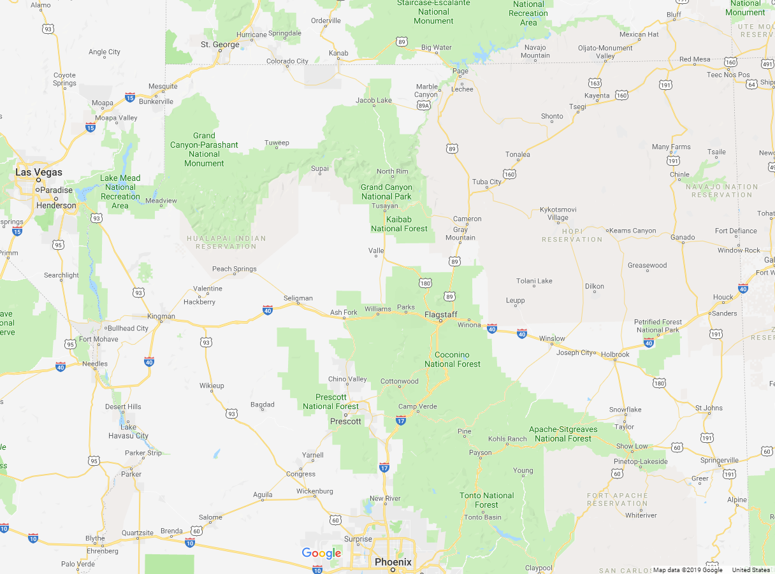
Mesa Verde
Mesa Verde
End Here
2 Places to Drive
To the bottom of
The Grand Canyon
Monument Valley
Monument Valley
Four Corners
Four Corners
Antelope Valley
Antelope Valley
Canyon de Shelly
Grand Canyon
Canyon de Shelly
Hoover Dam
Grand Canyon
Hoover Dam
Waupataki Nat’l Monument
Route 66
Store
Lowell Observatory
Lowell Observatory
Petrified Forest
“Radiator Springs”
“Radiator Springs”
Walnut Canyon
Oatman “Donkeys”
Oatman “Donkeys”
Sedona
Meteor Crater
Meteor Crater
Prescott
Out of Africa Park
Out of Africa Park
Natural Bridge
Natural Bridge
Start Here
Notes:
This is better if you play it through. Steps 1. Where is my vaction? 2. What can I see? 3. What are my priorities? (What do family members want to see?) COLOR CODING: Green (person wants it), Blue (Neat, but can be dropped), Red (other stuff found in the same area) 4. Are there any unique experiences I can add? PURPLE item

Slide 20
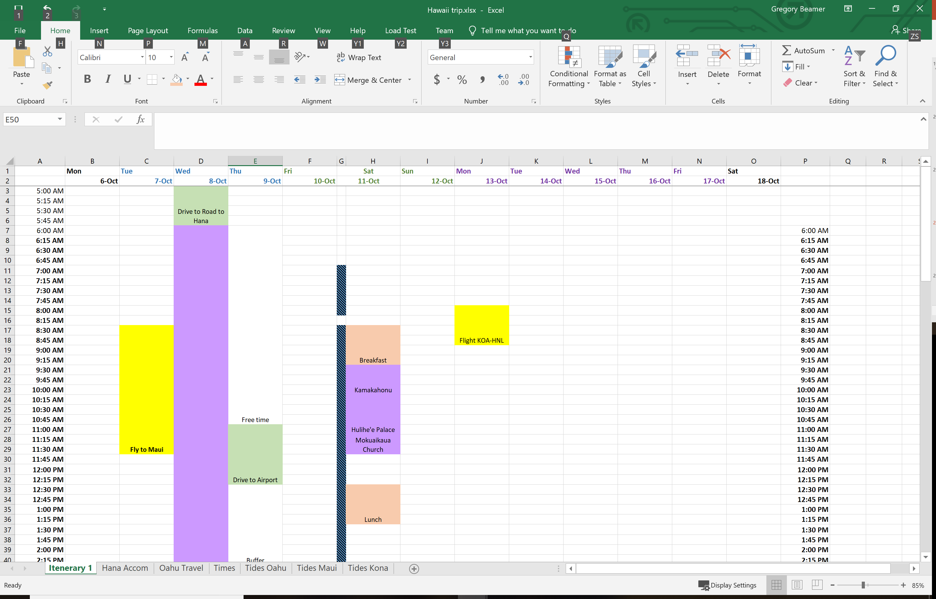
Notes:
Example of laying out a schedule as time

Slide 21
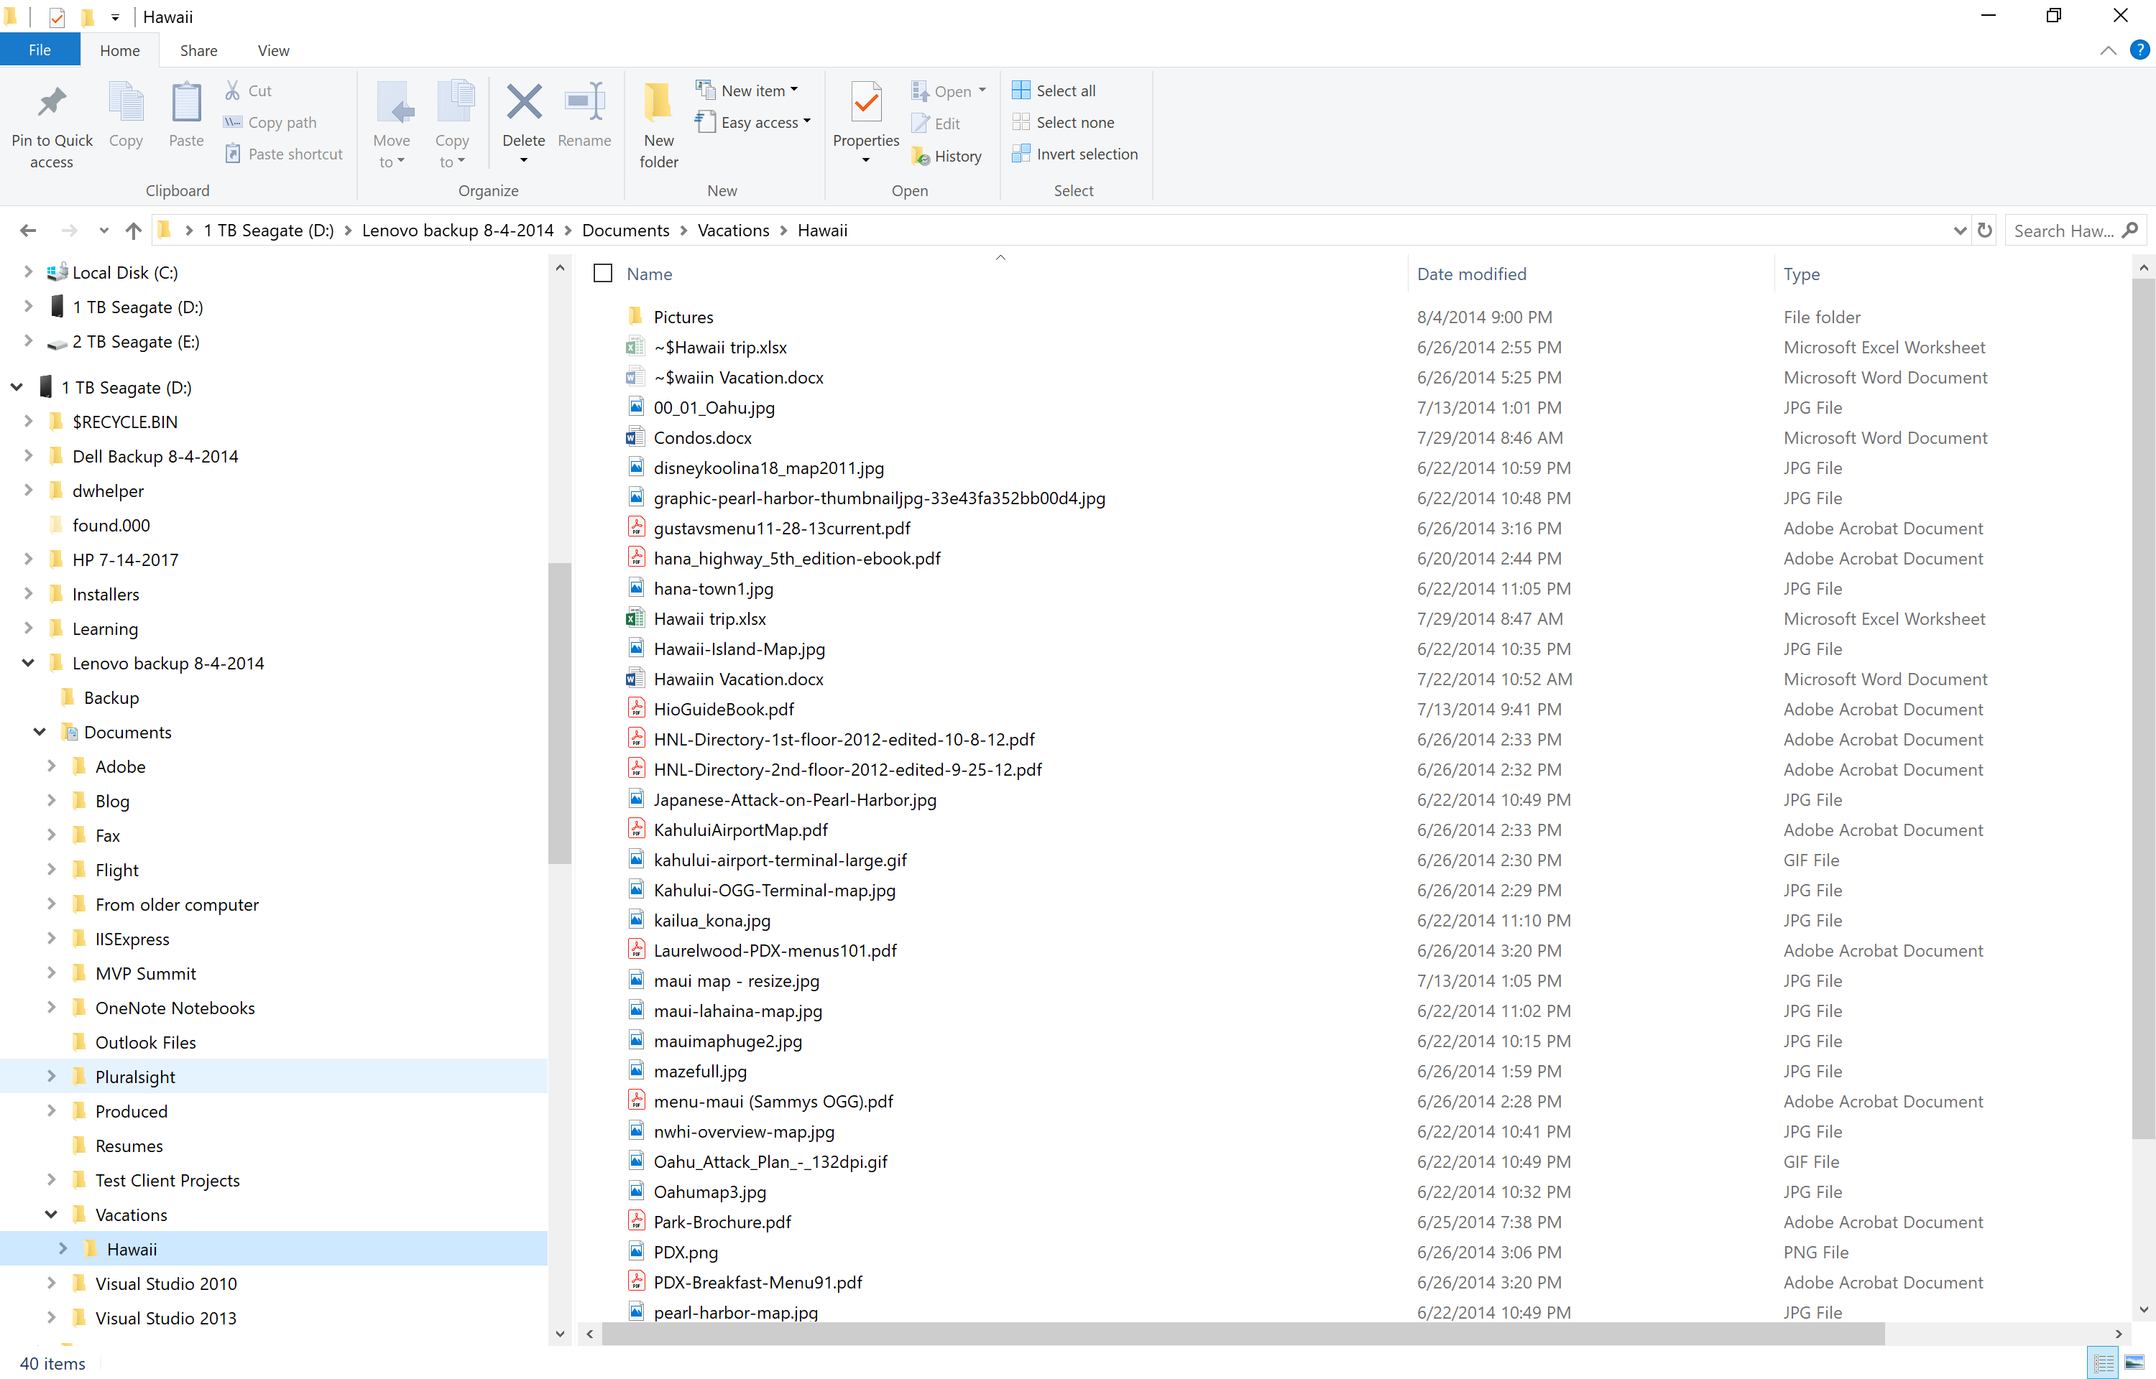
Notes:
Example of gathering documents for a trip (what is neat out there)

Slide 22
YES, He really does this!
- Tiffany Beamer
Notes:
My wife’s take

Slide 23
DaNG! This guy is Obsessed!
Notes:
Natural progression 1

Slide 24
DaNG! This guy is Possessed!
Notes:
Natural progression 2

Slide 25
DaNG! This guy is F ** KING CRAZY!
rea
Code Mash Friendly
Notes:
End point

Slide 26
1. Know Where You Are Going
Current State
Catalog the Functionality of Your Application
Map Functionality to Roles
Future State
Determine What Has to Be in The Future State of the Application
Do You Need Anything Else?
Map the Journey
How Do You Get From Here to There?
Notes:
For a trip, knowing when, where, starting point, ending point and the journey between is key

Slide 27
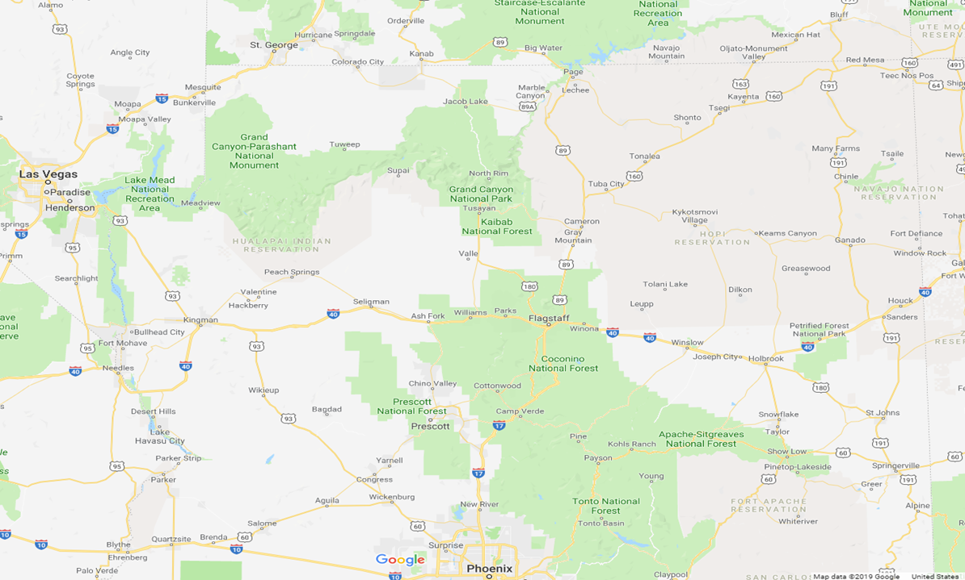
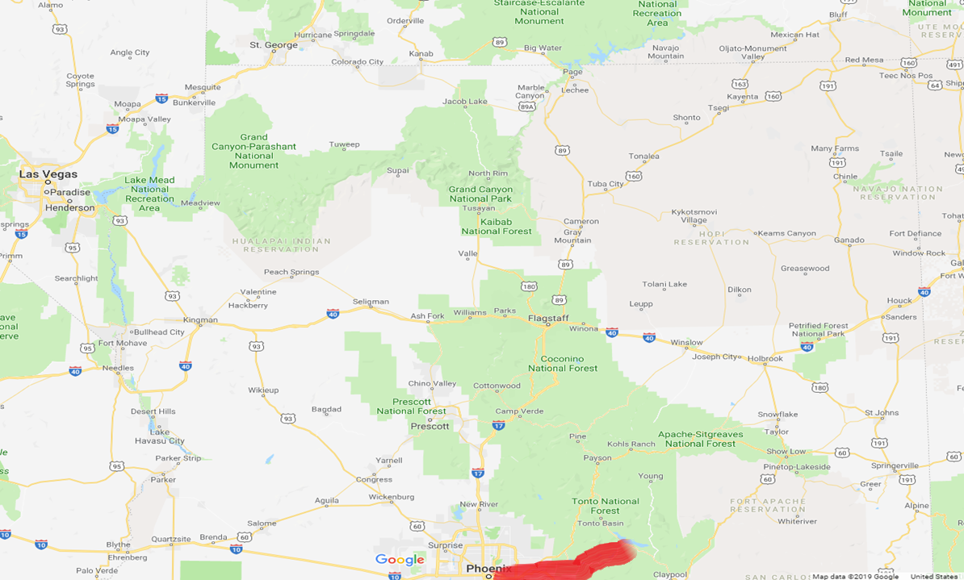
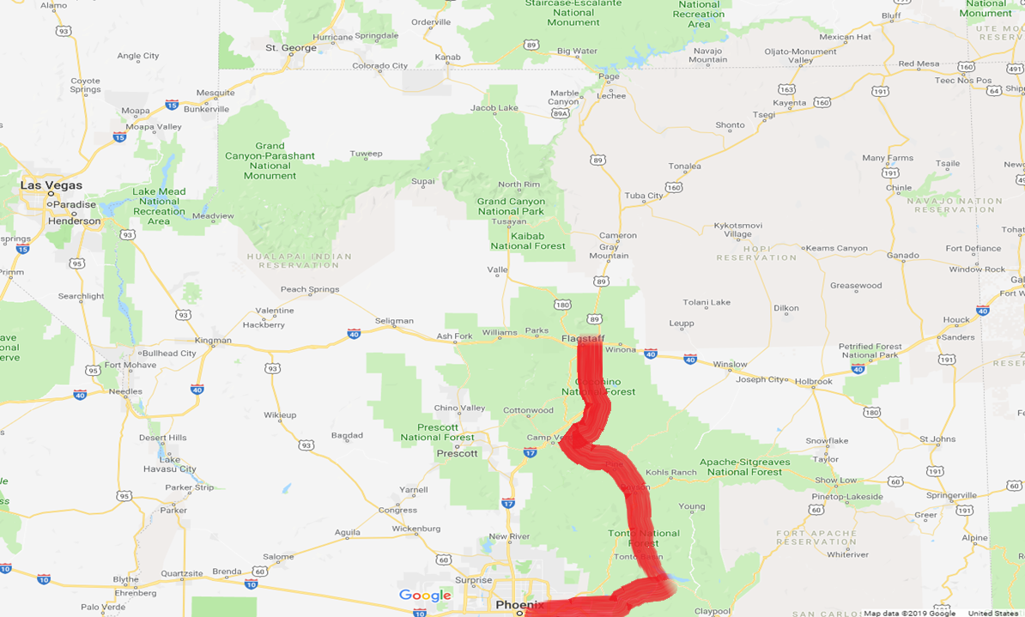
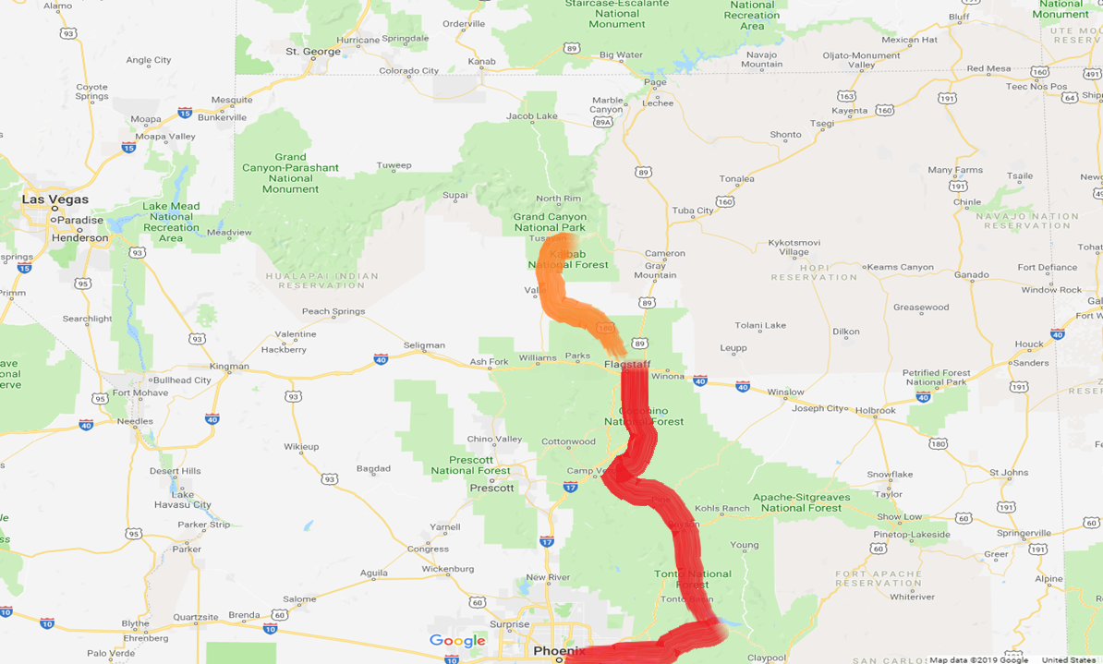
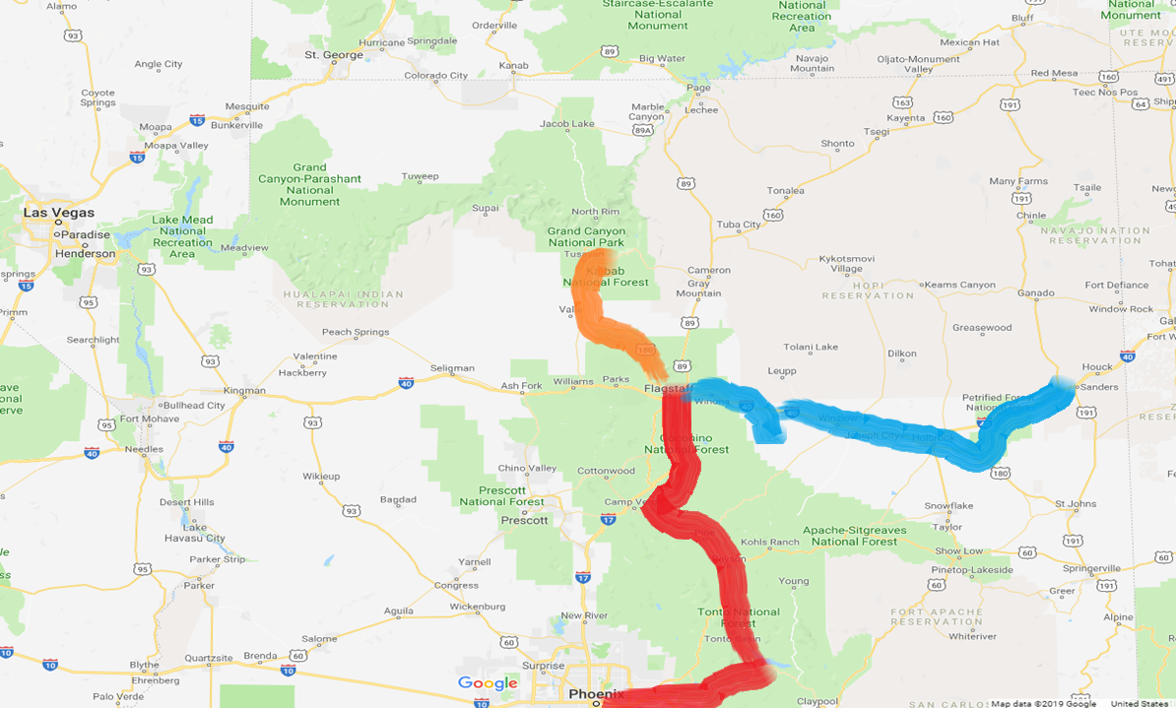
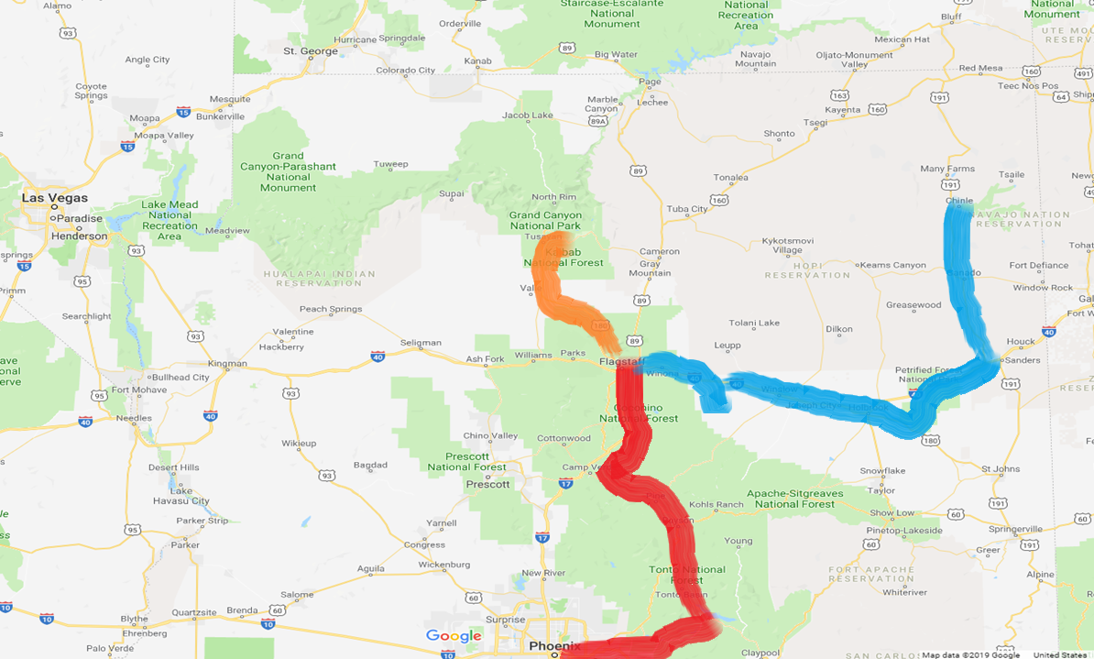
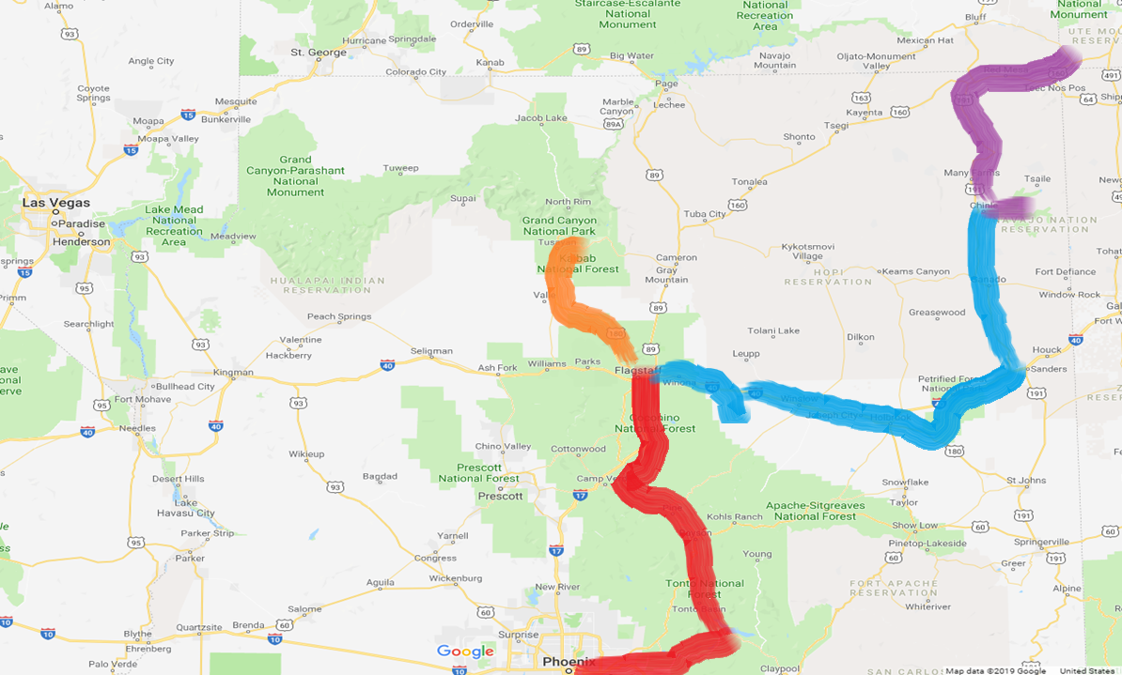
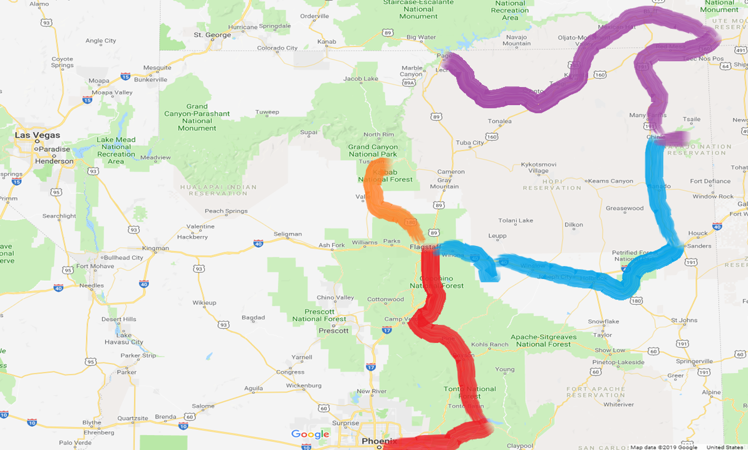
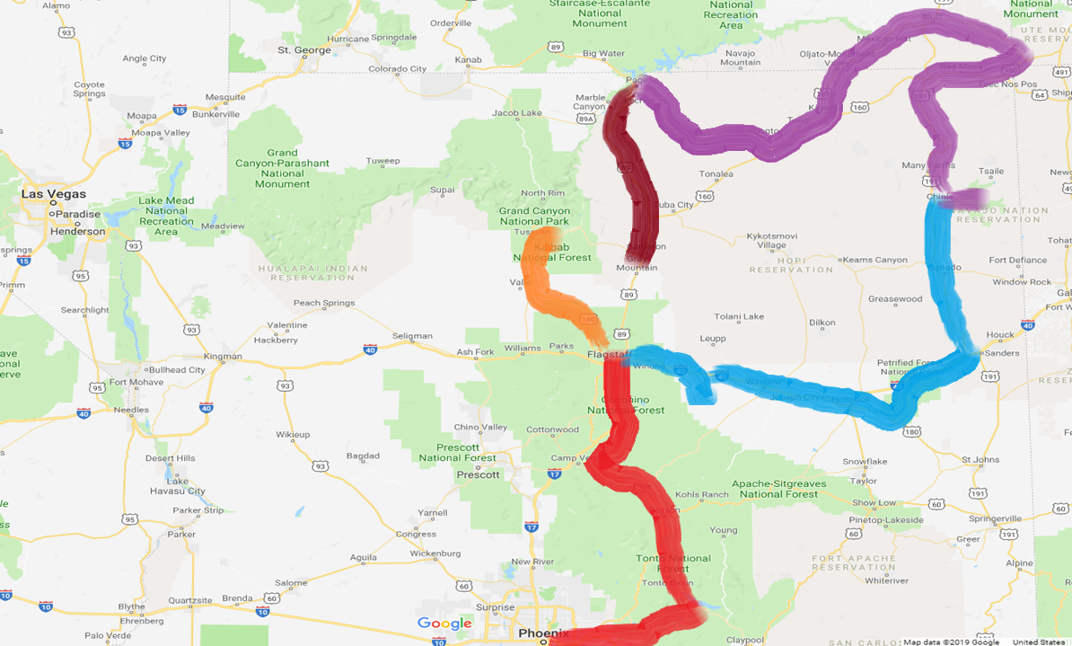
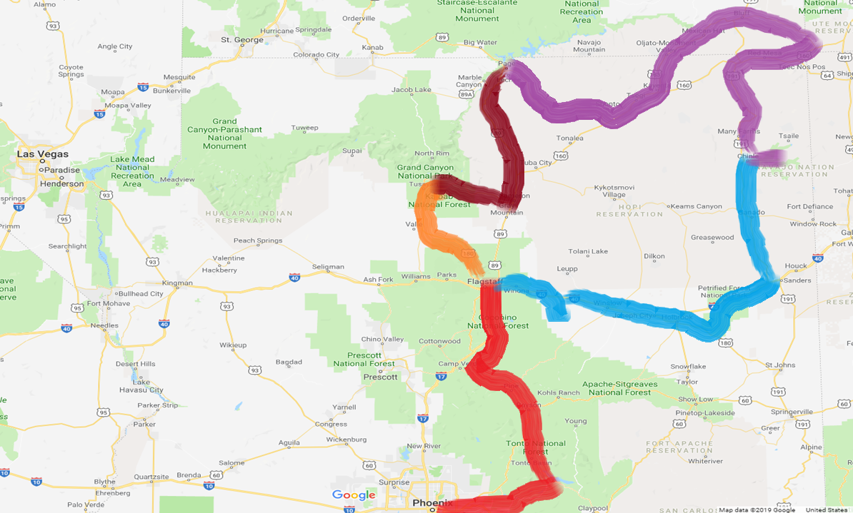
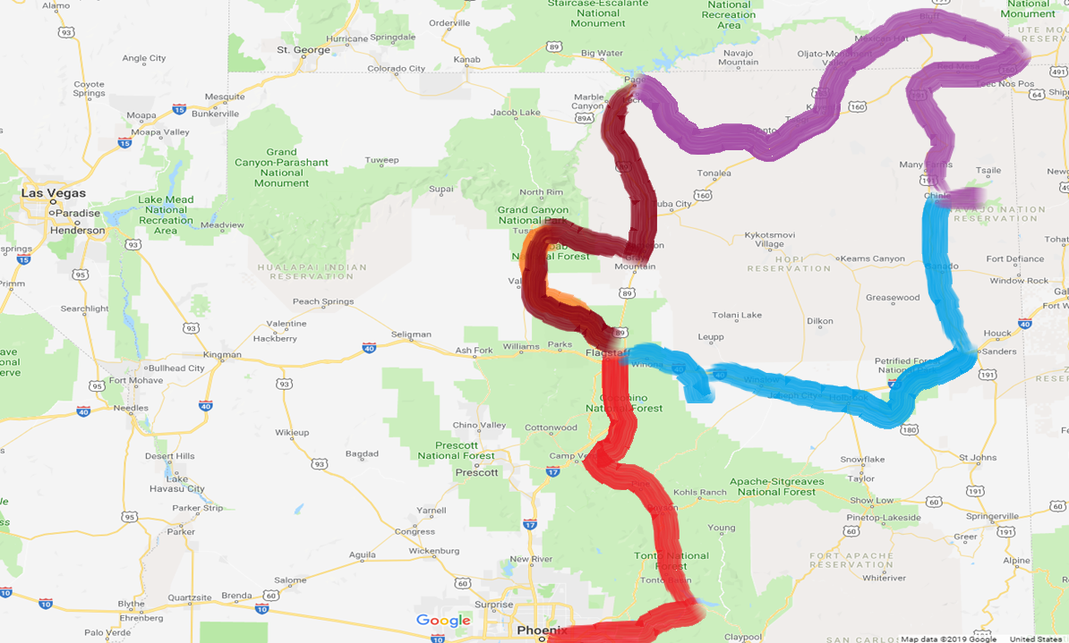
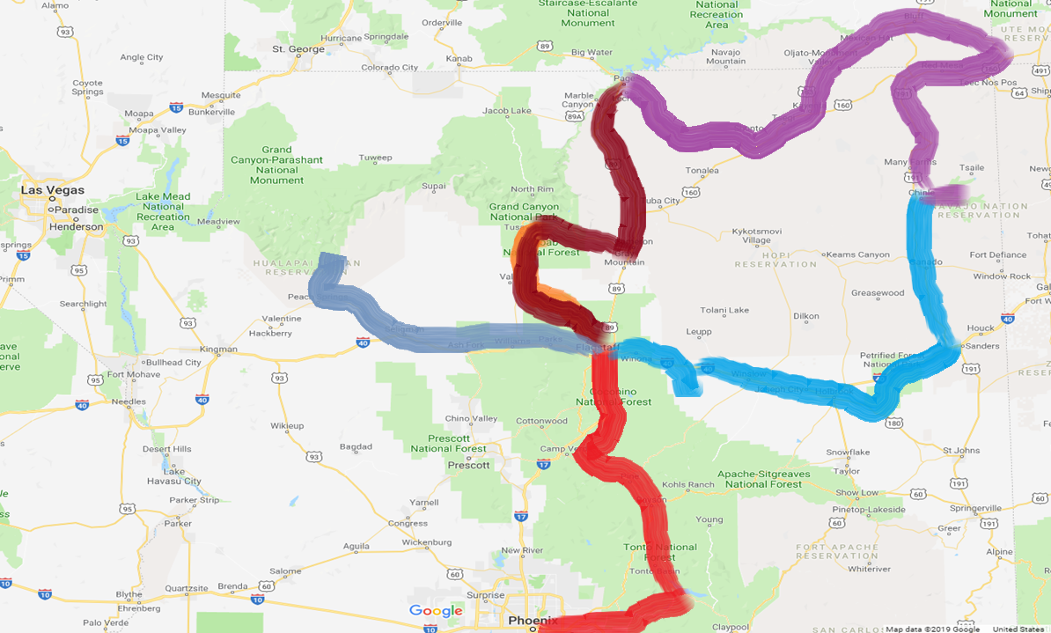
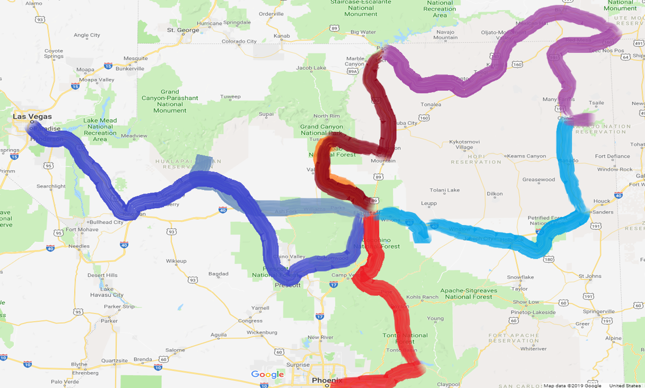
1.You Have To Know Where You Are Going
Monument
Valley
Horseshoe Bend
4 Corners
Grand Canyon (at Sunrise)
Canyon de
Shelly
Bottom of Grand Canyon
Route 66
Store
Hoover Dam
Waupataki
Winslow,
Arizona
Lowell Observatory
“Radiator Springs”
Meteor Crater
Petrified Forest
Prescott
Sedona
Out of Africa
Natural Bridge
Apache Trail
Notes:
7 phased vacation (each phase would be an architectural change in an app)

Slide 28
1. Know Where You Are Going
Kept
Discarded
ADDED
Natural Bridge
Out of Africa Park
Canyon De Shelly
Four Corners
Monument Valley
Grand Canyon
“Radiator Springs”
Hoover Dam
Lowell Observatory
Bottom of Grand Canyon (Hualapi)
Mesa Verde
Antelope Valley
Lee’s Ferry
Oatman Donkeys
Walnut Canyon
Waupataki NM
Vegas Strip
Route 66 Store
Prescott
Sedona
Notes:
These are the things kept, discarded (not enough time, not enough interest), and things added as they were “on the way”)

Slide 29
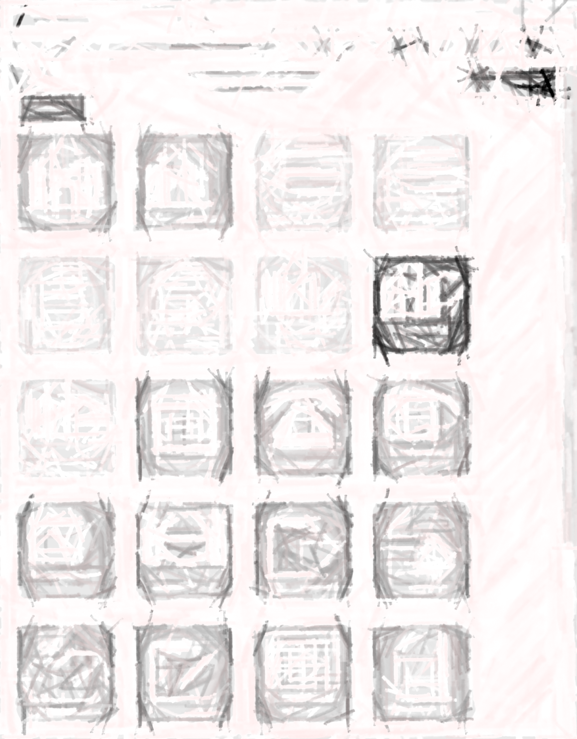
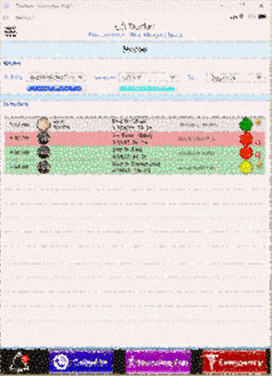
1. Know Where You Are Going
What you have
What you want
Notes:
Moving to real world

Slide 30
1. Know Where You Are Going
Kept
Discarded
ADDED
Schedule
Tasks
Timers
Shift Notes
Reports
Client Build
Administration
Better UX
Shift from Timers to State Tracking
Not truly Discarded
Notes:
Same exercise. What to keep, what to throw out, what to add -> Business user helps decided (end user, stakeholder, etc.) Discarded could be thrown out or just “not in this phase”

Slide 31
Rationalization (By Function)
Rationalization | Phase 1 | Phase 2 | Phase 3
Tolerate | Discard | Discard
Invest | Keep | Added | Discard
Migrate | Keep | Keep | Database Concerns
Eliminate |  | Old UX | Old DB
Notes:
Using the previous slide, this is how the items map to time, at a high level.

Slide 32
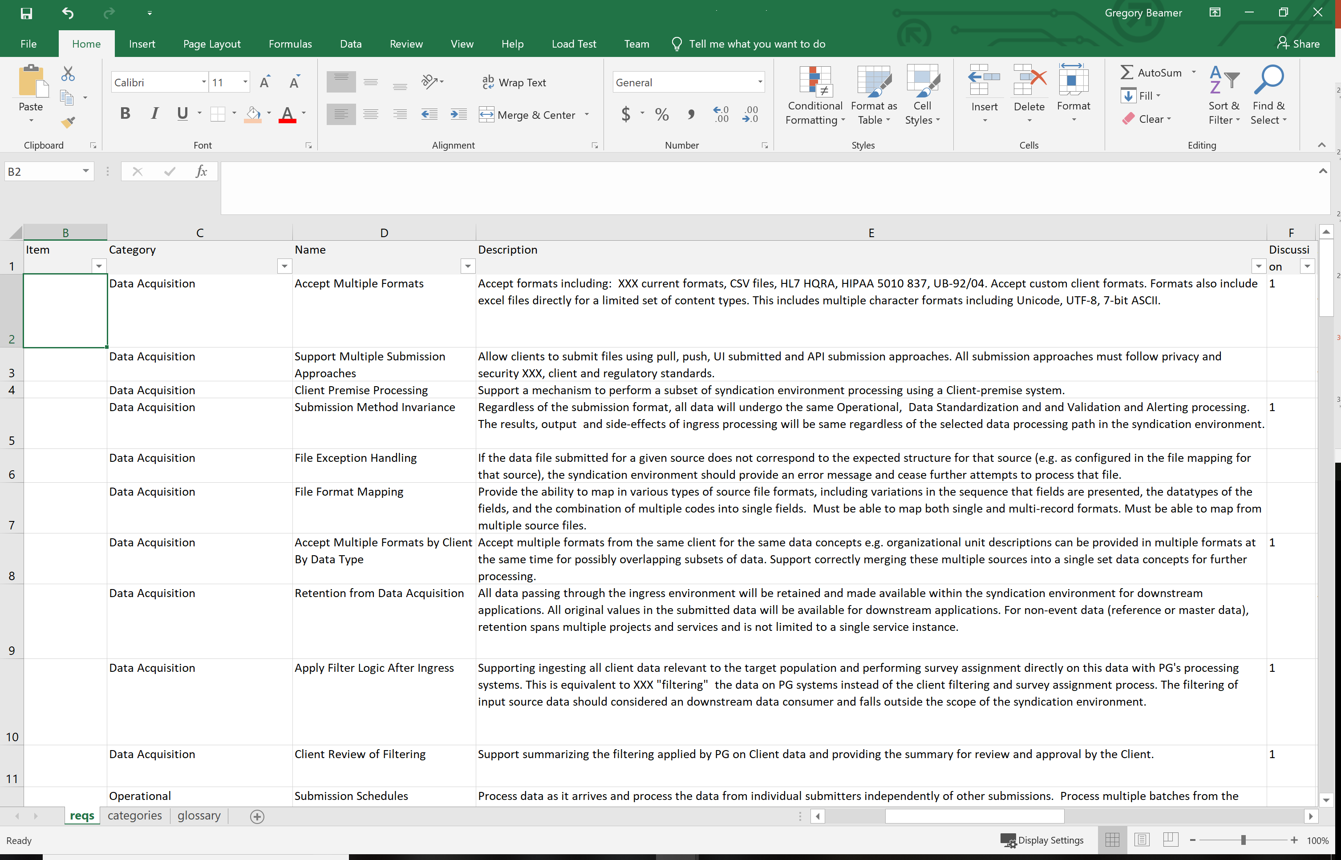
Notes:
This is an example of mapping functions (user stories work here in an Agile environment)

Slide 33
When to Invest, When to Migrate
Invest
Migrate
New Technology
Good Practices
Old technology
Possibly, Lack of Best Practices
Flaws Created Early in Development Cycle
Notes:
Determining invest (refactor) or migrate (rebuild) – Don’t just focus on OLD versus NEW

Slide 34
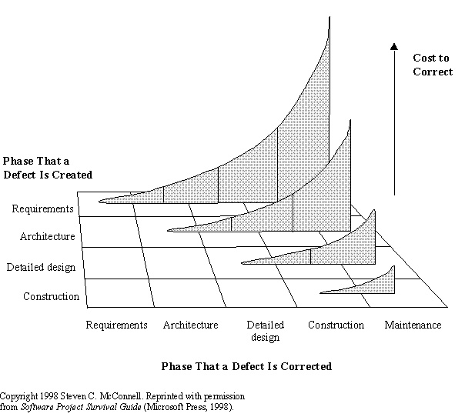
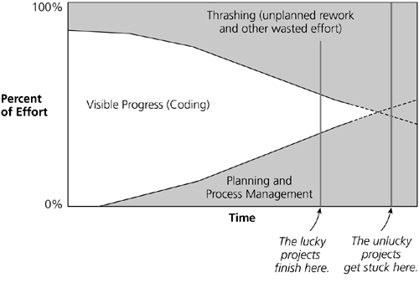
When to Invest, When to Migrate
https://www.construx.com/software-thought-leadership/books/software-project-survival-guide/
Notes:
McConnell diagram – design/architecture flaws Things are more expensive to fix (or untangle) the earlier they are introduced (left side). If the flaw is very early, even newer code may be worthy of replacement. RIGHT SIDE – Understanding why projects fail (lack of planning). NOTE: This deck is heavy on PLANNING

Slide 35
When to Invest, When To Migrate
Default to Invest (Refactor)
Impossible to Invest == Migrate (Rebuild)
More Expensive == Migrate
Complexity of Code Base Compared to Functionality
More Time Consuming to Invest - May Be Better to Migrate
Able to Utilize Product(s) to Speed Time To market
Notes:
In general, don’t rebuild. If it is more expensive or time consuming (read: more expensive), then you consider migration, otherwise invest (refactor)

Slide 36
When to Invest, When to Migrate
Invest
Migrate
Default to Invest Where Possible
Modern Technology
Best Practices Followed
When In Doubt, Consider Invest
Old Technology/Practices
Severe Design Flaws/Lack of Proper Practices
Incorrect architecture
Notes:
Summary of decision points

Slide 37
Building Through Cycles
Plan (already covered)
Find Seams in the Code
Organize the Code Base
Add Tests
Add Code (Assumes TDD/BDD approach (4 & 5 may flip in some instances))
Refactor
Release
Notes:
Steps to go through. You often return back to earlier steps over and over again, or repeat a set of steps over and over again. These are cycles within the larger cycle

Slide 38
2. Find Seams in Code Base
WHAT? > SOLID 101: Use Interfaces (I) to Separate (S) Concerns so You May Reverse Dependencies (D)
HOW? > Contract First Write Contracts [Interfaces in Most Languages]
Lesson Learned? Spaghetti Tastes Bad in Code: UI <> Business <> Data:
Notes:
Seams are separations between “layers”. They are in the form of contracts (interfaces in .NET code) and allow you to rebuild/refactor different parts of the application separately

Slide 39
3. Organize Code
For Migrate (New Solution), This is Creation of Projects
For Invest, This is a Reorganization Of Italian Food (Spaghetti)
Notes:
Organize the code means get the proper separation. You understand the seams, now create them.

Slide 40
Organizing the Code Base
Core AS Application
Test Driven/
Test Early Approach
BDD
ATDD
TDD
Adapter-based
Boundaries
TESTS
The CASA Model
ADAPTER
ADAPTER
CORE
CONTRACT
CONTRACT
ADAPTER
ADAPTER
Contract First Development
DOMAIN
Domain Driven Design
Notes:
The CASA model. The blue IS the application. Contracts and adapters ensure you can change Uis or databases, etc., without updating the application or rebuilding it. This future proofs the investment

Slide 41
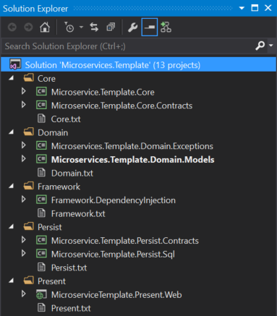
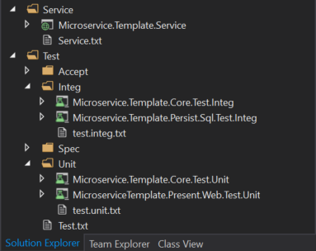
Notes:
This is what it looks like in .NET NOTE: The service in my version is now in the Present (Presentation == UI) folder NOTE: Persist is for persistence of state (think data storage?)

Slide 42
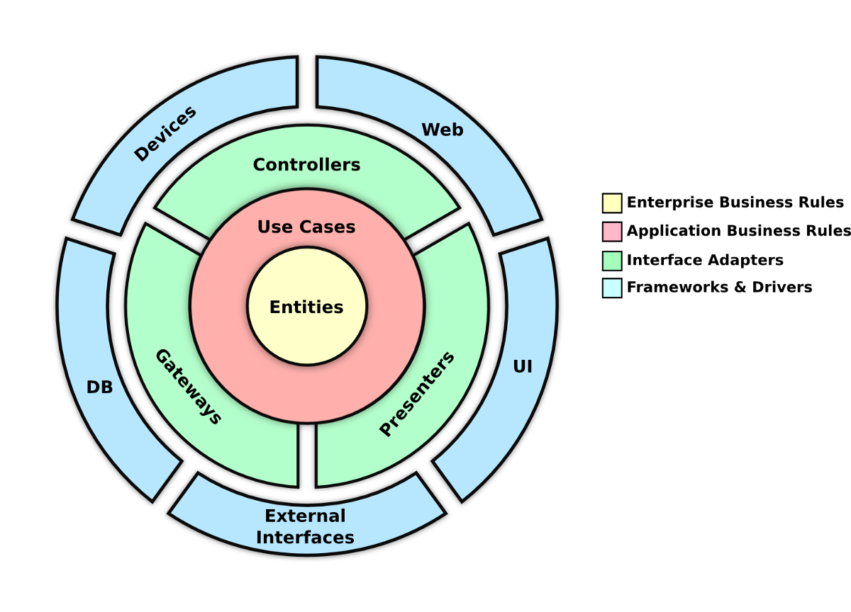
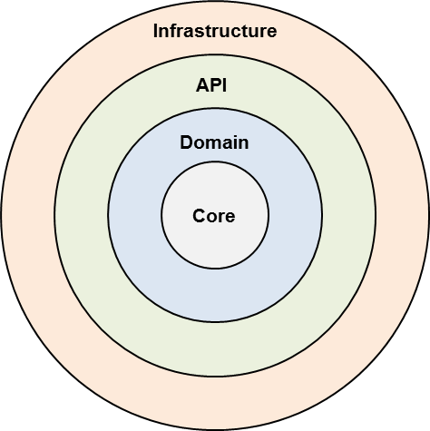
Same Thing – Different Expression
Hexagonal
Architecture
Onion
Architecture
Clean
Architecture
Notes:
Three “architectures” that fit the CASA models. Clean is the most hyped and well known today

Slide 43
4. Add Tests
Test Based on Acceptance
Know What is Acceptable and What Is Not
Ensure You Cover the Fringes
Consider White and Black Box Testing
Testing IS YOUR JOB (Even IF You Have a QA Department)
Focus on Behavior
Be Sensible About Code Coverage
Notes:
Computer SCIENCE == knowing your stuff works as expected. Main takeaway ➔ Acceptance (Acceptability to Business Users)

Slide 44
Be Sensible About Code Coverage
100% Code Coverage Means
You just Wasted Time and Money
You Tested Getters/Setters
You Tested Exception Initialization
You Probably Spent All Your Time on the “Happy Path”
You Spent More Time on Completion Than Acceptance
Use You Brain
Notes:
Code Coverage is a Metric, not a goal

Slide 45
5. Add Code
Break Out Work
Focus on Priorities (Agility 101?)
Make sure Your Tests Pass
Notes:
Here is where you develop stuff (yay?)

Slide 46
6. Refactor
You do Refactor Everything Right?
Notes:
Refactoring is simply making the code better. Every thing you write (Yes, Everything) should be refactored at some point.

Slide 47
7. Release
Staggered – By Function
Big Bang – Switching User’s Over Completely
Notes:
This is where you finally push something out – see next

Slide 48
7. Release
Staggered
Big Bang
Default to Staggered
Even if Release CANNOT be Incremental, Development SHOULD
When in Doubt, Consider Staggered
Low Overall Number of Functions
Functions Intertwined
Heavy Database Refactoring Requires A Single Move
Heavy Retraining
Notes:
In general, develop in iterations and release around business processes. If you can do any of the following, you can release and remove some pain for a group of users and then go to the next 1. All of the functionality for a specific role is done 2. All of the functionality for a specific business process is done The choice of the above is how you can slice up the work (specific group in the most pain #1, A specific process is biggest pain #2) In small apps, big bang can work, as well as something with a lot of spaghetti, requiring complete retraining, etc.

Slide 49
Examples
Legacy Modernization and Refactoring (Rebuild or Refactor)

Slide 50
Examples
VB/Classic ASP to .NET
IBM Mainframe to Java
Modern .NET to .NET

Slide 51
VB/ClassiC ASP To .NET
Use Tooling to Move Code (New Language/Platform, Old Paradigm) > Handles about 80-85% of Code Base
Add Tests
Reorganize and Rebuild (additional 15-20% Requires Rebuild)
Refactor to Proper .NET Usage
Repeat Steps 2-4 Above Until Completely in .NET Paradigm
Notes:
Migration: Microsoft Visual Basic Upgrade Companion (VBUC) – Free VS 2010, but larger supported product from Mobilize.Net
Other: VB Migration Partner, Great Migrations GM Studio

Slide 52
VB/Classic ASP To .NET
Paradigm Shift?
Classic VB Is COM Based, Not OO
Object Based, at Best
Requires Server (MTS?) To Run Properly with
More Custom Code Rather Than Frameworks
No Package Management (NuGet)
Classic ASP Is Interpreted, Not Compiled
Write Out Data, Instead of Binding
Not OO
Not Strongly Typed
Notes:
Using a tool to move code does not change the “thinking” in the code. Running VB style code in .NET is slow and clunky. Refactor so it is .NET code Example: Introduce Async?

Slide 53
IBM MainFrame to Java
Migrate - Options
Can Run Java On Mainframe
Can Migrate In Steps (Method Chosen)
Rebuild Functions From Scratch In New Language
Migrate In Steps
Migrate in Complete Functions/Function Areas
Notes:
Today you have a lot of options. A major decision point comes around expense and how much data you have to migrate if you move away from DB2.

Slide 54
IBM MainFrame to Java
Notes:
This shows the difference between a CICS (Mainframe) “program” (each screen (green screen) is a vertical slice from UI to data. Versus – modern application with a service back end (this fit the model for this client, not the only model)

Slide 55
IBM MainFrame to Java
Notes:
Migration (play slide for action) 1. Write Java side – new screen and logic 2. Then service for back end with business logic (this initially calls a service on the mainframe for data access) 3. Then you do more until you get the entire function covered 4. Now, you can move to the new data back end 5. Finally decommission that function on the Mainframe side You can move everything below the green screens onto Java and the database before moving the user to the web app OR You can move the user function by function (in this case 3 screens == function) The point is migration to java code is not dependent on migration of users off UI. And the “big bang” move (retraining) can be after they have been using the new application (underlying the screens) for a lengthy period of time

Slide 56
Modern Code Base, Improper Practices, Design & Architecture Flaws
Mixture of Invest and Migrate
Migrate: New UI/UX (Responsive to Native)
Utilize Services During UI/UX Rebuild
Update Database to Best Practices
Notes:
When it is a modern application, you may punt on some code (rebuild) and refactor others (favor refactor)

Slide 57
Modern Code Base, Improper Practices, Design & Architecture Flaws
Migrate
Invest
Rebuild UI/UX
Move from CRUD Services to Function/Capability Based
Switch Synchronization Method
Switch Out Custom CORS Implementation
Reorganize Code
Add Tests
Update Database
Notes:
General guidelines on migration (rebuild) and invest (refactoring)

Slide 58
Modern Code Base, Improper Practices, Design & Architecture Flaws
Kept
Discarded
ADDED
Schedule
Tasks
Timers
Shift Notes
Reports
Client Build
Administration
Better UX
Shift from Timers to State Tracking
Not truly Discarded
Notes:
Do we keep or discard. Anything to add while we modernize?

Slide 59
Modern Code Base, Improper Practices, Design & Architecture Flaws
Rationalization | Phase 1 | Phase 2 | Phase 3
Tolerate | Discard | Discard
Invest | Keep | Added | Discard
Migrate | Keep | Keep | Database Concerns
Eliminate |  | Old UX | Old DB
Notes:
Mapping the areas to phases

Slide 60
Modern Code Base, Improper Practices, Design & Architecture Flaws
Mobile App
Web App
ADDED
Schedule
Tasks
Timers
Shift Notes
Reports
Client Build
Administration
Both
Better UX
Mobile
Shift from Timers to State Tracking
Notes:
In this case, the keep becomes our mobile app for field use. The discard stays legacy for a bit and is then moved to a web app. And we tackle some pain points.

Slide 61
Notes:
Animations
Flow to Mobile app
Contracts to separate areas of concern (SOLID design principles)
Add service based on contract
Now have choices where to hook into older application
Or even start creating your own data access on the same database (no table changes at this point)
The same process works for pieces on the web application

Slide 62
Database Migration Steps
Notes:
For the database, the services already abstract the data access. So you can add proper structures (schemas or separate database) and expand the DAL to talk to old and new tables while you transition NOTE: Old database put to bed when the work is done

Slide 63
Database Migration – Key Points
Point Services to New And Old
Focus On Priorities
Migrate in Steps
Deprecate Old Tables in Steps
New Functionality built on New, Old Still on Old
Do Not Waste Time & Money Updating Things You are Eliminating
Notes:
Some key points for this particular migration (that may work for you) 1. A service (implementation of a contract) can talk to multiple back ends. So you don’t have to move the entire UI at one time. (Maintaining two sets of tables can be expensvie, but not as disruptive as big bang user switches) 2. When you do this, the functionality gets split (it means I can still do reporting on the old system while I have my field users on the new front end, with a new database)

Slide 64
Reality 101
Small Steps
You Don’t Plan Enough!
Soooooo – You Don’t Know Enough!
Safety & Money are Competing Concerns
When In Doubt, Keep the Lights On
It is About Business Functions, Not Code
Don’t Forget Your End Users

Slide 65
Practical Steps To Modernizing Legacy Applications
An Architectural Journey
Gregory A. Beamer
@gbworld

